Slide 1


Employee Attrition Analysis: A Comprehensive Guide
NAME:MANOJ KUMAR N
REGISTER NO :312211640
DEPARTMENT: commerce GENERAL
COLLEGE:THIRUTHANGAL NADAR COLLEGE

Slide 2
Data Preparation in Excel
Data Gathering
Data Cleaning
Data Organization
Start by collecting relevant employee data from your HR system or other sources.
Ensure data accuracy and consistency. Remove duplicates, correct typos, and standardize data formats.
Organize the data in a structured format, using columns and rows.
This facilitates analysis and makes it easier to manipulate and calculate metrics.
Include employee ID, hire date, termination date, department, role, and any other relevant factors.
Clean data is crucial for accurate analysis and reliable insights.

Slide 3


Calculating Attrition Rates
1
Attrition Rate Calculation
2
Annual Attrition Rate
Calculate the attrition rate using a formula that divides the number of employees who left by the average number of employees during a specific period.
The annual attrition rate reflects the percentage of employees who left the organization over a year.
3
Monthly Attrition Rate
4
Voluntary vs. Involuntary Attrition
The monthly attrition rate calculates the percentage of employees who left during a particular month.
Distinguish between voluntary and involuntary attrition to understand the reasons behind employee departures.

Slide 4

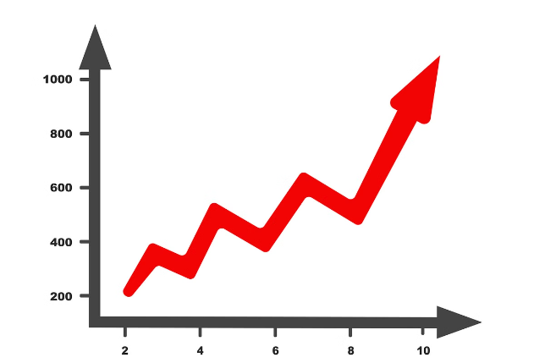
Identifying Attrition Patterns
1
Trend Analysis
Identify any trends in attrition over time. Look for peaks and dips in the attrition rate.
2
Seasonal Patterns
Examine if attrition rates vary seasonally. Certain periods may experience higher attrition due to factors like holidays or industry cycles.
3
Outliers
Investigate any unusual spikes or dips in attrition. Identify potential causes for these outliers and their impact.

Slide 5

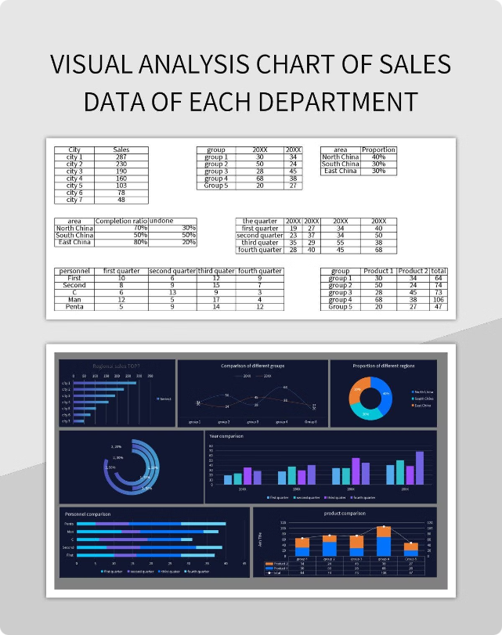
Analyzing Attrition by Department
Department
Attrition Rate
Average Tenure
Sales
15%
2.5 years
Marketing
10%
3 years
Engineering
5%
4 years
HR
8%
2.8 years

Slide 6


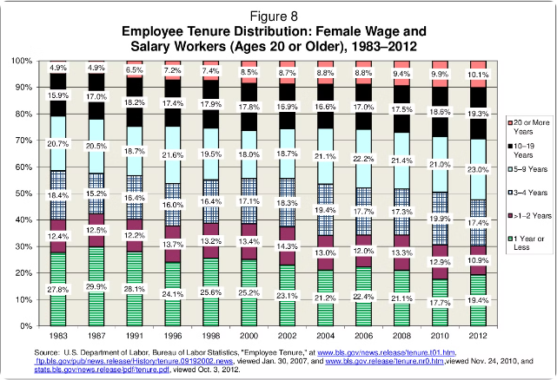


Attrition by Tenure and Role
Tenure
Analyze attrition rates based on employee tenure. Identify if certain tenure groups experience higher attrition.
Role
Examine attrition rates by job roles. Determine if specific roles are associated with higher turnover.
Combination
Consider the combined impact of tenure and role on attrition. Identify potential patterns or correlations.

Slide 7


Exploring Reasons for Attrition
Exit Interviews
Employee Surveys
Conduct exit interviews with departing employees to gather feedback on their reasons for leaving.
Regularly conduct employee surveys to gauge satisfaction, morale, and identify potential areas for improvement.
Performance Reviews
Manager Feedback
Review performance evaluations to identify any patterns or trends in employee feedback and performance issues.
Gather feedback from managers regarding employee performance, workload, and team dynamics.

Slide 8

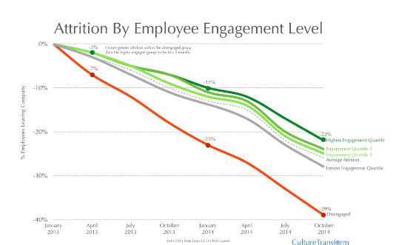
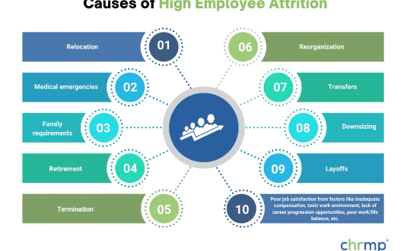
Visualizing Attrition Data
Bar Charts
Line Charts
Pie Charts
Use bar charts to compare attrition rates across departments, roles, or tenure groups.
Illustrate attrition trends over time, highlighting seasonal variations or spikes.
Represent the proportion of employees who left due to different reasons, providing insights into key drivers of attrition.

Slide 9






Strategies to Reduce Attrition
Employee Engagement
Professional Development
Implement initiatives to boost employee engagement, motivation, and satisfaction.
Provide opportunities for professional growth and development to enhance skills and career prospects.
Leadership Development
Open Communication
Develop effective leaders who can foster a positive and supportive work environment.
Create an open and transparent communication channel to address employee concerns and feedback.

Slide 10


Conclusion and Key Takeaways
Employee attrition analysis is crucial for organizations to understand and address underlying issues. By using Excel to analyze attrition patterns and identify key drivers, organizations can develop effective strategies to improve employee retention and build a stronger workforce.

